Slide 1
cloud computing
Presented By:-
Sophiya Sheikh

Slide 2
What is Cloud?
The term Cloud refers to a Network or Internet. In other words, we can say that Cloud is something, which is present at remote location. Cloud can provide services over network, i.e., on public networks or on private networks, i.e., LAN or VPN.
Applications such as e-mail, web conferencing, customer relationship management (CRM), all run in cloud.

Slide 3
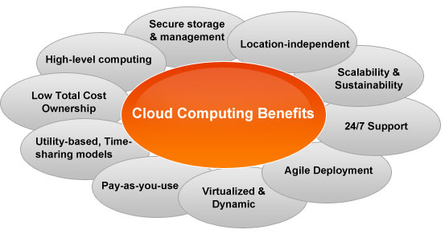
Why Cloud

Slide 4
What is Cloud Computing ?
Cloud computing is a virtual environment providing IT services on low cost and using third party access for it.
“Cloud Computing is a new computing paradigm that is built on virtualization, distributed computing, utility computing and service oriented architecture”.

Slide 5
Continue..
Cloud Computing refers to manipulating, configuring, and accessing the applications online. It offers online data storage, infrastructure and application.
We need not to install a piece of software on our local PC and this is how the cloud computing overcomes platform dependency issues. Hence, the Cloud Computing is making our business application mobile and collaborative.

Slide 6
Cloud Computing - Overview
Cloud Computing provides us a means by which we can access the applications as utilities, over the Internet. It allows us to create, configure, and customize applications online.
This can reduce complexity; fulfill hardware requirement and client side requirements. It is very popular now a day and because it handle massive amount of data.

Slide 7
Definition
"Cloud computing is a model for enabling convenient, on-demand network access to a shared pool of configurable computing resources (e.g., networks, servers, storage, applications, and services) that can be rapidly provisioned and released with minimal management effort or service provider interaction.

Slide 8
Elementary Definition
The cloud is just a mutation form of the Internet. Cloud computing signifies storing and accessing data and programs over the Internet instead of your computer’s hard drive.
Cloud computing means storing and accessing data and programs over the Internet instead of your computer’s hard drive. The cloud is just a metaphor for the Internet.
Cloud Computing can be defined as a computer technology that yields the processing power of many inter-networked computers while impersonating the structure that is behind it.

Slide 9
Technical Perspective
Cloud computing refers to an efficient method of managing lots of computer servers, data storage and networking.
The evolution of the term “cloud” can be preferred to the anonymous nature of this technology’s framework; the system works for users yet they really have no idea the inherent complexities that the system utilizes.
Cloud is a new evolution of IT service delivery from a remote location, either over the Internet or an intranet, involving multi-tenant environments enabled by virtualization.

Slide 10
In Researchers’ Point of View
Cloud computing is a model for enabling convenient, on-demand network access to a shared pool of configurable computing resources (e.g., networks, servers, storage, applications, and services) that can be rapidly provisioned and released with minimal management effort or service provider interaction.

Slide 11
Virtualization
Through virtualization, Cloud computing is able to address with the same physical infrastructure a large client base with different computational needs. In contrast to previous paradigms (Clusters and Grid computing), Cloud computing is not application-oriented but service-oriented; it offers on-demand virtualized resources as measurable and billable utilities.

Slide 12
History of Cloud Computing
Before emerging the cloud computing, there was Client/Server computing which is basically a centralized storage in which all the software applications, all the data and all the controls are resided on the server side.
If a single user wants to access specific data or run a program, he/she need to connect to the server and then gain appropriate access, and then he/she can do his/her business.
Then after, distributed computing came into picture, where all the computers are networked together and share their resources when needed.

Slide 13
Continue..
The actual history of Cloud computing is not that old, the first business and consumer Cloud Computing services website (Salesforce.com and Google) were launched in 1999.
Cloud computing is tied directly to the development of the Internet and Business technology since Cloud computing is the solution to the problem of how the Internet can help improve Business Technology.
Business technology has long and fascinating history, one that is almost as long as business itself, but the development that most directly influenced the history of Cloud computing start with the emergence of computers as providers of real business solutions.

Slide 14
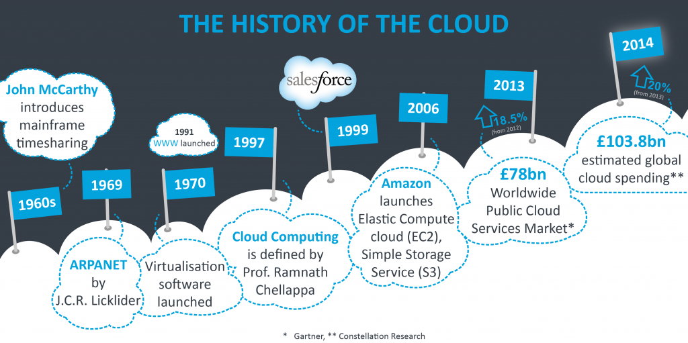

Slide 15
Continue
EARLY 1960S
  The computer scientist John McCarthy, come up with concept of timesharing, and enabling Organization to simultaneously use an expensive mainframe. This computing is described as a significant contribution to the development of the Internet, and a pioneer of Cloud computing.
IN 1969
  The idea of an “Intergalactic Computer Network” or “Galactic Network” (a computer networking concept similar to today’s Internet) was introduced by J.C.R. Licklider, who was responsible for enabling the development of ARPANET (Advanced Research Projects Agency Network). His vision was for everyone on the globe to be interconnected and being able to access programs and data at any site, from anywhere.

Slide 16
Continue..
IN 1970
  Using virtualization software like VMware. It become possible to run more than one Operating System simultaneously in an isolated environment. It was possible to run a completely different Computer (virtual machine) inside a different Operating System.
IN 1997
  The first known definition of the term “Cloud Computing” seems to be by Prof. Ramnath Chellappa in Dallas in 1997 – “A computing paradigm where the boundaries of computing will be determined by economic rationale rather than technical limits alone.”

Slide 17
Continue..
IN 1999
  The arrival of Salesforce.com in 1999 pioneered the concept of delivering enterprise applications via simple website. The services firm covered the way for both specialist and mainstream software firms to deliver applications over the Internet.
IN 2002
  In 2002, Amazon started Amazon Web Services, providing services like storage, computation and even human intelligence.
IN 2003
  The first public release of Xen, which creates a Virtual Machine Monitor (VMM) also known as a hypervisor, a software system that allows the execution of multiple virtual guest operating systems simultaneously on a single machine.

Slide 18
Continue..
IN 2006
  In 2006, Amazon expanded its cloud services. First was its Elastic Compute cloud (EC2), which allowed people to access computers and run their own applications on them, all on the cloud.
  Then they brought out Simple Storage Service (S3). This introduced the pay-as-you-go model to both users and the industry as a whole, and it has basically become standard practice now.
IN 2009
  In 2009, Google Apps also started to provide cloud computing enterprise applications.
  In 2009, Microsoft launched Windows Azure, and companies like Oracle and HP have all joined the game.

Slide 19
Continue..
IN 2013
  The Worldwide Public Cloud Services Market totalled £78bn, up 18.5 per cent on 2012, with IaaS (infrastructure-as-a-service) the fastest growing market service.
IN 2014
  In 2014, global business spending for infrastructure and services related to the cloud will reach an estimated £103.8bn, up 20% from the amount spent in 2013 (Constellation Research).

Slide 20
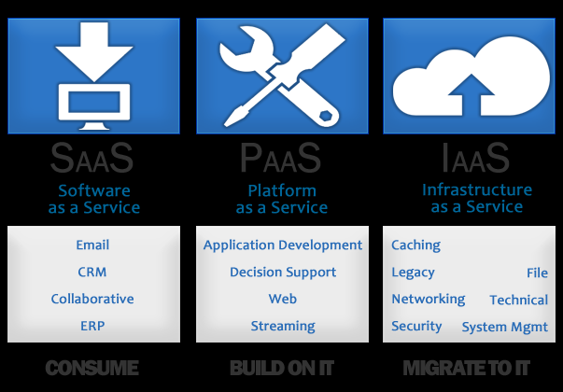
Cloud Computing Architecture

Slide 21
Need and Benefits of Cloud Computing
Cloud computing is perhaps the most flamboyant technological innovation of the 21st century. This is because it has seen the fastest adoption into the mainstream than any other technology in the domain. This adoption has been fueled mainly by the ever-increasing number of smartphones and mobile devices that can access the internet.
Cloud computing is not just for organizations and businesses; it’s also useful for the average person as well.
It enables us to run software programs without installing them on our computers; it enables us to store and access our multimedia content via the internet, it enables us to develop and test programs without necessarily having servers and so on.
Cloud computing is a 21st-century marvel that holds its importance in almost every field you can think of.

Slide 22
Continue..
Basically, we need cloud computing because of the numerous individual and business problems that we encounter today.
These problems range from acquiring and maintaining expensive hardware and software resources that we use in our daily operations to streamlining these resources in the most efficient manner for our benefit and the benefit of the society at large.
In handling these challenges, cloud computing offers numerous benefits that have surpassed our expectations and delivered more than we had previously thought. These benefits are as follows:

Slide 23
Flexibility
Users can scale services to fit their needs, customize applications and access cloud services from anywhere with an internet connection.
  Scalability
  Cloud infrastructure scales on demand to support fluctuating workloads.
  2. Storage options
  Users can choose public, private or hybrid storage offerings, depending on security needs and other considerations.
  3. Control choices
  Organizations can determine their level of control with as-a-service options. These include software as a service (SaaS), platform as a service (PaaS) and infrastructure as a service (IaaS).
  4. Tool selection
  Users can select from a menu of prebuilt tools and features to build a solution that fits their specific needs.
  5. Security features
  Virtual private cloud, encryption and API keys help keep data secure.

Slide 24
Efficiency
Enterprise users can get applications to market quickly, without worrying about underlying infrastructure costs or maintenance.
1. Accessibility
Cloud-based applications and data are accessible from virtually any internet-connected device.
2. Speed to market
Developing in the cloud enables users to get their applications to market quickly.
3. Data security
Hardware failures do not result in data loss because of networked backups.
4. Savings on equipment
Cloud computing uses remote resources, saving organizations the cost of servers and other equipment.
5. Pay structure
A “utility” pay structure means users only pay for the resources they use.

Slide 25
Strategic Value
Cloud services give enterprises a competitive advantage by providing the most innovative technology available.
1. Streamlined work
Cloud service providers (CSPs) manage underlying infrastructure, enabling organizations to focus on application development and other priorities.
2. Regular updates
Service providers regularly update offerings to give users the most up-to-date technology.
3. Collaboration
Worldwide access means teams can collaborate from widespread locations.
4. Competitive edge
Organizations can move more nimbly than competitors who must devote IT resources to managing infrastructure.

Slide 26
Components Of Cloud Computing Architecture
All kinds of businesses, let it be small-scale large-scale, are shifting to cloud-based services.
The adoption of both public and private clouds have increased in the past few years.
The reason behind this shift is lower operating costs and increased flexibility.
Cloud computing technology utilizes remote servers to store, manage, and access data on the internet rather than have a local infrastructure.

Slide 27
Why Cloud Computing?
In cloud computing, we can develop new applications and services, store and backup our data, host blogs, and websites, analyze the data, and stream audio and video.
There is no need for large and complex cloud computing infrastructure as the storage and processing are done on remote servers called cloud servers.

Slide 28
As the software platform and databases are hosted remotely, the individual computers are free from the storage and computing tasks.
Cloud computing offers a wide range of benefits, including high efficiency, cost reduction, data security, scalability, mobility, disaster recovery, and complete control over the data.

Slide 29
The Components
The cloud computing architecture consists of two parts front end and the back end, the front end part is the one that is used by the user, and the back end part is managed by the host. Both ends are connected to each other via the internet.
The frontend includes applications and interfaces that help the user access the cloud services. The company offering cloud services manages the back end and has data storage facilities, virtual machines, security systems, and servers.

Slide 30
Continue..
1. Client Infrastructure
The client infrastructure component is the part of the frontend which provides a graphic user interface for the user to interact with the cloud.
2. Application
An application is any platform like an app or software offered by a company by which the clients access the cloud.
3. Service
A cloud service manages the kind of service that a client needs to use according to his requirement. There are three types of services in cloud computing.

Slide 31
Continue..
-Software as a Service (SaaS): SaaS-based services are known as cloud application services. They run directly through a web browser eliminating the need for any download or installation of the applications—for example, slack Hubspot and Google apps.
-Platform as a Service (PaaS): PaaS services are similar to SaaS. However, PaaS services provide a platform for users to build, edit, and launch the software. For example, Magneto commerce cloud and Windows Azure.

Slide 32
Continue..
-Infrastructure as a service (IaaS): IaaS manages application data runtime environments and middleware. It provides virtual services that eliminate the need for physical computing resources such as RAM, CPU, and data centres. In IaaS, the companies run virtual servers, networks, and storage on the cloud on a paid basis. For example, Google Compute Engine (GCE), Amazon Elastic Compute Cloud, and Amazon Web Services (AWS).

Slide 33
Continue..
4. Runtime Cloud
The runtime cloud provides the execution and runtime environment to the virtual machines.
5. Storage
The storage component of cloud computing provides the storage capacity in the cloud for storing and managing data. In cloud storage, the data can be accessible to multiple clients simultaneously. Cloud storage is generally in the form of three basic configurations: public cloud, private cloud, and hybrid cloud.

Slide 34
Continue..
6. Infrastructure
The infrastructure provides services on the host level, application level, and network level. It includes the software and hardware components such as the storage network devices server and any other storage resource required to support the cloud computing model.
7. Management
Management is used for managing the components such as storage services, applications, runtime cloud infrastructure, and security issues in the backend and for establishing coordination.

Slide 35
Continue..
8. Security
Security is the backend component of cloud computing, which insurance the security of data in the cloud. The security system in the cloud includes a broad set of policies, technologies, applications, and controls that are used for protecting the IP’s, data, applications, infrastructure, and the services offered in cloud computing.
9. Internet
Internet is the medium using which the frontend and backend components communicate and interact with each other.

Slide 36
Characteristics of Cloud Computing
As cloud computing services mature both commercially and technologically, it will be easier for companies to maximize the potential benefits. Knowing what cloud computing is and what it does, however, is just as important. The National Institute of Standards and Technology (NIST) defines cloud computing as it is known today through five particular characteristics.

Slide 37
Continue..
On-demand self-service
  Cloud computing resources can be provisioned without human interaction from the service provider. In other words, a manufacturing organization can provision additional computing resources as needed without going through the cloud service provider. This can be a storage space, virtual machine instances, database instances, and so on.
Broad network access
  Cloud computing resources are available over the network and can be accessed by diverse customer platforms. It other words, cloud services are available over a network—ideally high broadband communication link—such as the internet, or in the case of a private clouds it could be a local area network (LAN).

Slide 38
Continue..
Multi-tenancy and resource pooling
  Cloud computing resources are designed to support a multi-tenant model.
  Multi-tenancy allows multiple customers to share the same applications or the same physical infrastructure while retaining privacy and security over their information.
  It’s similar to people living in an apartment building, sharing the same building infrastructure but they still have their own apartments and privacy within that infrastructure. That is how cloud multi-tenancy works.

Slide 39
Continue..
Rapid elasticity and scalability
  Cloud computing resources can scale up or down rapidly and, in some cases, automatically, in response to business demands.
  It is a key feature of cloud computing. The usage, capacity, and therefore cost, can be scaled up or down with no additional contract or penalties.
  Elasticity is a landmark of cloud computing and it implies that manufacturing organizations can rapidly provision and de-provision any of the cloud computing resources.
  Rapid provisioning and de-provisioning might apply to storage or virtual machines or customer applications.

Slide 40
Continue..
With cloud computing scalability, there is less capital expenditure on the cloud customer side.
This is because as the cloud customer needs additional computing resources, they can simply provision them as needed, and they are available right away. Scalability is more planned and gradual.
For instance, scalability means that manufacturing organizations are gradually planning for more capacity and of course the cloud can handle that scaling up or scaling down.

Slide 41
Continue..
Measured service
  Cloud computing resources usage is metered, and manufacturing organizations pay accordingly for what they have used. Resource utilization can be optimized by leveraging charge-per-use capabilities.
  This means that cloud resource usage—whether virtual server instances that are running or storage in the cloud—gets monitored, measured and reported by the cloud service provider.
  The cost model is based on “pay for what you use”—the payment is variable based on the actual consumption by the manufacturing organization.

Slide 42
Disadvantages of Cloud Computing
There are benefits from cloud computing usage but it is undeniable that this system also has some disadvantages. The risks of cloud computing you should know such as:
  #1. Risk of data confidentiality
  There is always a risk that user data can be accessed by other people. So, data and cloud protection must be good because it won’t be dangerous for data confidentiality.

Slide 43
Continue..
#2. Depends on internet connection
The internet is the only way to cloud computing. When there is no internet connection in your place, or the internet path to the cloud provider is in trouble, automatically access to your cloud computing machine will be disconnected. Now this is where the biggest obstacle is happening in developing countries and remote areas that do not have good internet access. And the weakness of public cloud is where everyone accesses the same server and server and will increase the risk of attack, and down the server.

Slide 44
Continue..
#3. The level of security
Secrecy and security are among the most doubtful things in cloud computing. By using a cloud computing system means we are fully entrusted with the security and confidentiality of data to companies that provide cloud computing servers. When you experience a problem, you cannot sue the server for errors in the data. When you experience a problem, you cannot sue the server for errors in the data.

Slide 45
Continue..
#4. Compliance
Which refers to the risk of a level compliance deviation from the provider against the regulations applied by the user.
#5. Vulnerable in the event of an attack
There are lots of arguments against cloud computing one of which is computing because the Cloud Computing work system is online, each component that is on Cloud Computing can be exposed to a wide range, this is a wide-open opportunity for attacks on data or activities stored on the server. When an attack is carried out by hackers, the problems that occur are data security and data privacy.

Slide 46
Continue..
#6. Data Mobility
Which refers to the possibility of sharing data between cloud services and how to retrieve data if one day the user makes a process of terminating cloud computing services. And there is local storage where the data can be used at any time as needed.
#7. Technical problem
Besides that the use of Cloud Computing makes you unable to manage it yourself when there is a problem or a problem, you must contact customer support who is not necessarily ready 24/7. This is a problem because for some support you also have to pay more money.

Slide 47
Continue..
#8. Low Connection
Does not work well if the connection is slow. The quality of cloud computing servers is one of the most important considerations before we decide to provide cloud computing server service, providers. When the server is down or the performance is not good, we will be harmed because of poor server quality.

Slide 48
Cloud Computing Applications
Cloud service providers provide various applications in the field of art, business, data storage, and backup services, education, entertainment, management, social networking, etc.
The most widely used cloud computing applications are given below -

Slide 49
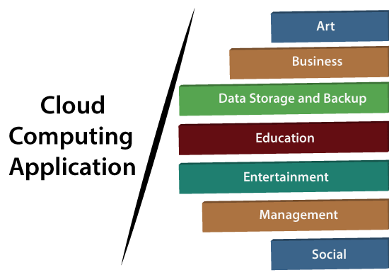
Continue..

Slide 50
1. Art Applications
Cloud computing offers various art applications for quickly and easily design attractive cards, booklets, and images. Some most commonly used cloud art applications are given below:
i Moo
Moo is one of the best cloud art applications. It is used for designing and printing business cards, postcards, and mini cards.
ii. Vistaprint
Vistaprint allows us to easily design various printed marketing products such as business cards, Postcards, Booklets, and wedding invitations cards.
iii. Adobe Creative Cloud
Adobe creative cloud is made for designers, artists, filmmakers, and other creative professionals. It is a suite of apps which includes PhotoShop image editing programming, Illustrator, InDesign, TypeKit, Dreamweaver, XD, and Audition.

Slide 51
2. Business Applications
Business applications are based on cloud service providers. Today, every organization requires the cloud business application to grow their business. It also ensures that business applications are 24*7 available to users.
There are the following business applications of cloud computing -
i. MailChimp
MailChimp is an email publishing platform which provides various options to design, send, and save templates for emails.
ii. Salesforce
Salesforce platform provides tools for sales, service, marketing, e-commerce, and more. It also provides a cloud development platform.

Slide 52
Continue..
iii. Chatter
Chatter helps us to share important information about the organization in real-time.
iv. Bitrix24
Bitrix24 is a collaboration platform that provides communication, management, and social collaboration tools.
v. Paypal
Paypal offers the simplest and easiest online payment mode using a secure internet account. Paypal accepts the payment through debit cards, credit cards, and also from Paypal account holders.

Slide 53
Continue..
vi. Slack
Slack stands for Searchable Log of all Conversation and Knowledge. It provides a user-friendly interface that helps us to create public and private channels for communication.
vii. Quickbooks
Quickbooks works on the terminology "Run Enterprise anytime, anywhere, on any device." It provides online accounting solutions for the business. It allows more than 20 users to work simultaneously on the same system.

Slide 54
3. Data Storage and Backup Applications
Cloud computing allows us to store information (data, files, images, audios, and videos) on the cloud and access this information using an internet connection. As the cloud provider is responsible for providing security, they offer various backup recovery applications for retrieving the lost data.
A list of data storage and backup applications in the cloud are given below -

Slide 55
i. Box.com
Box provides an online environment for secure content management, workflow, and collaboration. It allows us to store different files such as Excel, Word, PDF, and images on the cloud. The main advantage of using box is that it provides drag & drop service for files and easily integrates with Office 365, G Suite, Salesforce, and more than 1400 tools.
ii. Mozy
Mozy provides powerful online backup solutions for our personal and business data. It schedules automatically back up for each day at a specific time.

Slide 56
iii. Joukuu
Joukuu provides the simplest way to share and track cloud-based backup files. Many users use joukuu to search files, folders, and collaborate on documents.
iv. Google G Suite
Google G Suite is one of the best cloud storage and backup application. It includes Google Calendar, Docs, Forms, Google+, Hangouts, as well as cloud storage and tools for managing cloud apps. The most popular app in the Google G Suite is Gmail. Gmail offers free email services to users.

Slide 57
4. Education Applications
Cloud computing in the education sector becomes very popular. It offers various online distance learning platforms and student information portals to the students. The advantage of using cloud in the field of education is that it offers strong virtual classroom environments, Ease of accessibility, secure data storage, scalability, greater reach for the students, and minimal hardware requirements for the applications.
There are the following education applications offered by the cloud -

Slide 58
Continue..
i. Google Apps for Education: Google Apps for Education is the most widely used platform for free web-based email, calendar, documents, and collaborative study.
ii. Chromebooks for Education: Chromebook for Education is one of the most important Google's projects. It is designed for the purpose that it enhances education innovation.
iii. Tablets with Google Play for Education: It allows educators to quickly implement the latest technology solutions into the classroom and make it available to their students.
iv. AWS in Education: AWS cloud provides an education-friendly environment to universities, community colleges, and schools.

Slide 59
5. Entertainment Applications
Entertainment industries use a multi-cloud strategy to interact with the target audience. Cloud computing offers various entertainment applications such as online games and video conferencing.
i. Online games
Today, cloud gaming becomes one of the most important entertainment media. It offers various online games that run remotely from the cloud. The best cloud gaming services are Shaow, GeForce Now, Vortex, Project xCloud, and PlayStation Now.

Slide 60
ii. Video Conferencing Apps
Video conferencing apps provides a simple and instant connected experience. It allows us to communicate with our business partners, friends, and relatives using a cloud-based video conferencing. The benefits of using video conferencing are that it reduces cost, increases efficiency, and removes interoperability.

Slide 61
6. Management Applications
Cloud computing offers various cloud management tools which help admins to manage all types of cloud activities, such as resource deployment, data integration, and disaster recovery. These management tools also provide administrative control over the platforms, applications, and infrastructure.
Some important management applications are -
i. Toggl
Toggl helps users to track allocated time period for a particular project.
ii. Evernote
Evernote allows you to sync and save your recorded notes, typed notes, and other notes in one convenient place. It is available for both free as well as a paid version.

Slide 62
iii. Outright
Outright is used by management users for the purpose of accounts. It helps to track income, expenses, profits, and losses in real-time environment.
iv. GoToMeeting
GoToMeeting provides Video Conferencing and online meeting apps, which allows you to start a meeting with your business partners from anytime, anywhere using mobile phones or tablets. Using GoToMeeting app, you can perform the tasks related to the management such as join meetings in seconds, view presentations on the shared screen, get alerts for upcoming meetings, etc.

Slide 63
7. Social Applications
Social cloud applications allow a large number of users to connect with each other using social networking applications such as Facebook, Twitter, Linkedln, etc.
There are the following cloud based social applications -
i. Facebook
Facebook is a social networking website which allows active users to share files, photos, videos, status, more to their friends, relatives, and business partners using the cloud storage system. On Facebook, we will always get notifications when our friends like and comment on the posts.

Slide 64
Continue..
ii. Twitter
Twitter is a social networking site. It is a microblogging system. It allows users to follow high profile celebrities, friends, relatives, and receive news. It sends and receives short posts called tweets.
iii. Yammer
Yammer is the best team collaboration tool that allows a team of employees to chat, share images, documents, and videos.
iv. LinkedIn
LinkedIn is a social network for students, freshers, and professionals.

Slide 65
Cloud Deployment Model
A cloud deployment model is a specific configuration of environment parameters such as the accessibility and proprietorship of the deployment infrastructure and storage size. It means that deployment types vary depending on who controls the infrastructure and where it resides.
There are four types of them: public, private, hybrid and community clouds. Additionally, there are also distributed clouds, multiclouds, poly clouds and other models, but they are not so widespread.

Slide 66
Public Cloud
The name speaks for itself: public clouds are available to the general public, and data are created and stored on third-party servers.
Server infrastructure belongs to service providers that manage them and administer pool resources, which is why there is no need for user companies to buy and maintain their hardware.
Provider companies offer resources as a service both free of charge or on a pay-per-use basis via the Internet connection. Users can scale resources when required.
Examples are Amazon Elastic Compute Cloud (Amazon EC2) — the top service provider, Microsoft Azure, Google App Engine, IBM Cloud, Salesforce Heroku and others.

Slide 67
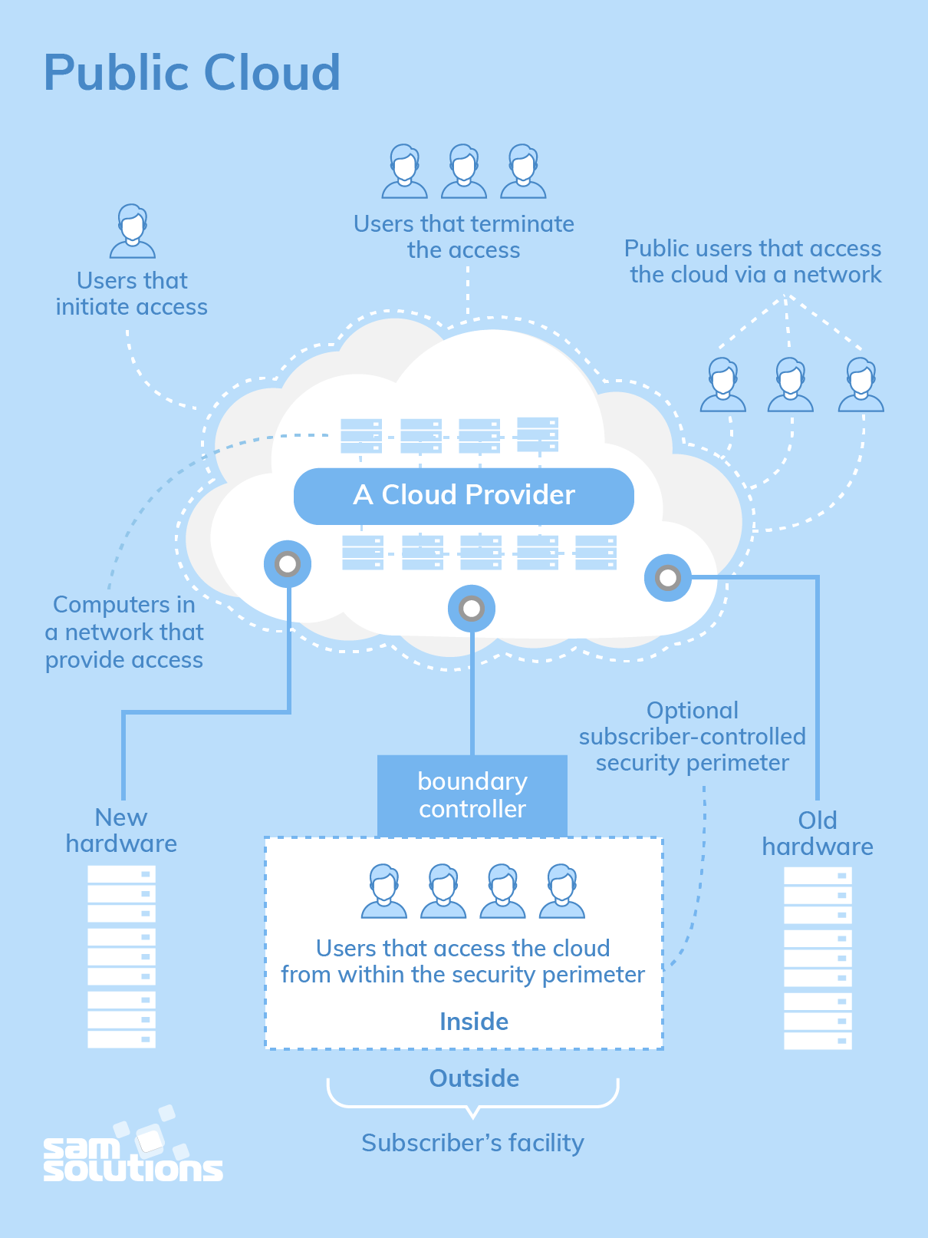

Slide 68
The Advantages of a Public Cloud
Hassle-free infrastructure management. Having a third party running your cloud infrastructure is convenient: you do not need to develop and maintain your software as the service provider does it for you.
High scalability. You can easily extend the available capacity as your company requirements increase.
Reduced costs. You pay only for the service you use, no need to invest in hardware or software.
24/7 uptime. An extensive network of the provider’s servers ensures the constant availability of your infrastructure and its improved operation time.

Slide 69
The Disadvantages of a Public Cloud
Compromised reliability. That same server network is also meant to ensure against failures. But often enough, public clouds experience outages and malfunction, as it was in the case of the Salesforce CRM disruption in 2016 that caused a storage collapse.
Data security and privacy give rise to concern. Although access to data is easy, a public deployment model deprives users of knowing where their information is kept and who has access to it.
The lack of a bespoke service. Service providers have only standardized service options, which is why they will probably fail to satisfy their requirements if they are unusual.

Slide 70
Private Cloud
There is little to no difference between a public and a private model from the technical point of view, as their architectures are very similar. However, opposed to a public cloud that is available to the general public, only one specific company owns a private one. That is why it is also called an internal or corporate.
Only one organization uses this deployment model to run its workloads, and the server can be hosted externally or on the premises of the user company. Regardless of their physical location, these infrastructures are maintained on a designated private network and use software and hardware that are intended for a specific company.

Slide 71
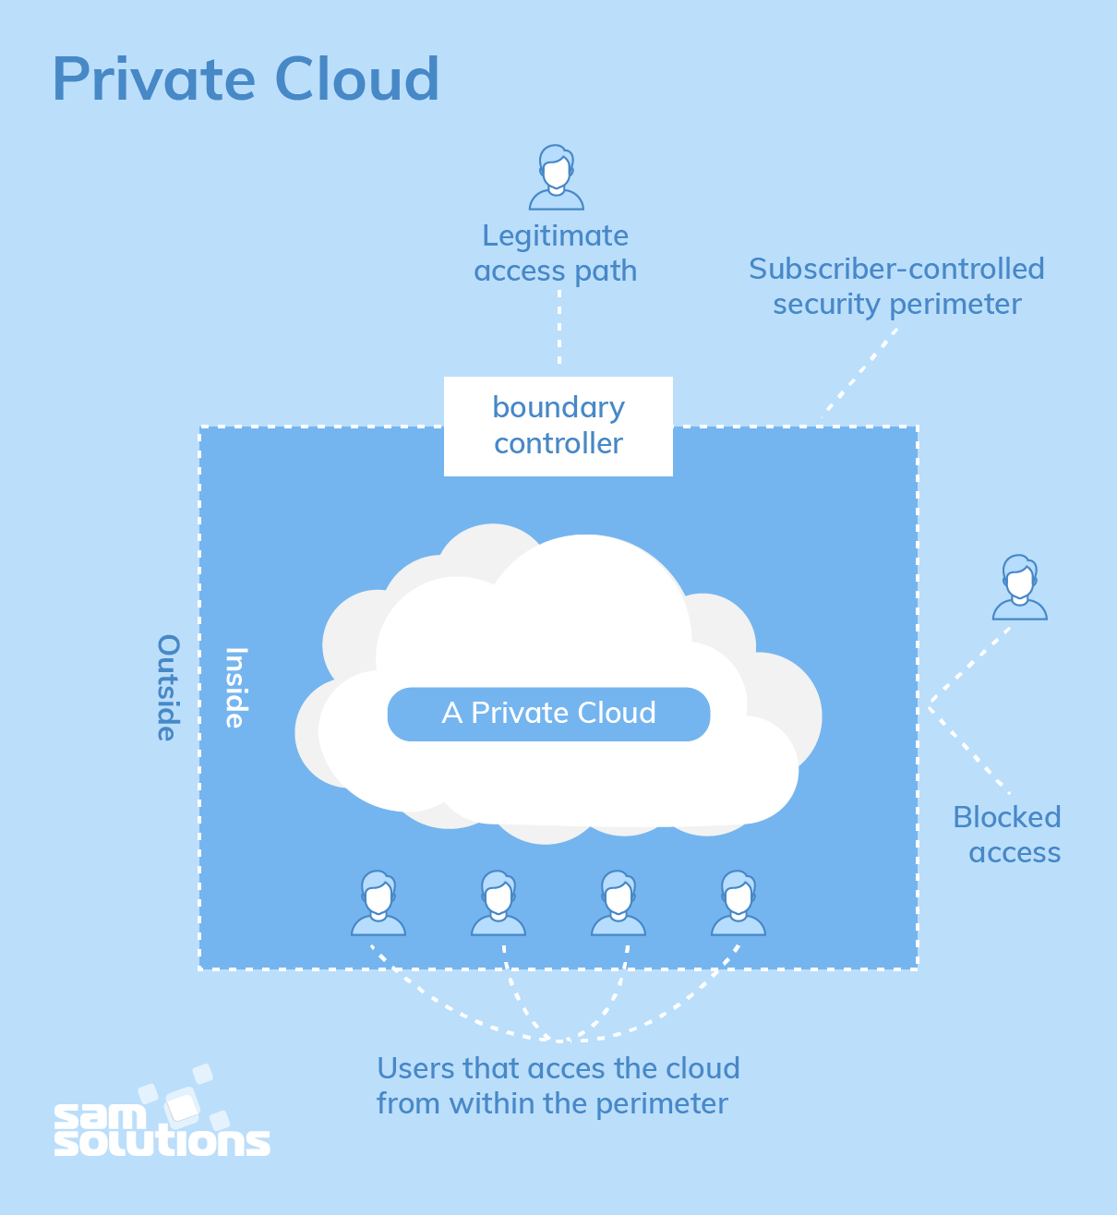

Slide 72
The Benefits of a Private Cloud
All the benefits of this deployment model result from its autonomy. They are the following
  Bespoke and flexible development and high scalability, which allows companies to customize their infrastructures in accordance with their requirements
  High security, privacy and reliability as only authorized persons can access resources

Slide 73
The Drawbacks of a Private Cloud
The major disadvantage of the private cloud deployment model is its cost, as it requires considerable expenses on hardware, software and staff training. That is why this secure and flexible computing deployment model is not a choice for small companies.

Slide 74
Community Cloud
A community deployment model largely resembles a private one; the only difference is the set of users. While a private type implies that only one company owns the server, in the case of a community one, several organizations with similar backgrounds share the infrastructure and related resources.
If the organizations have uniform security, privacy and performance requirements, this multi-tenant data center architecture helps companies achieve their business-specific objectives. That is why a community model is particularly suited for organizations that work on joint projects.

Slide 75
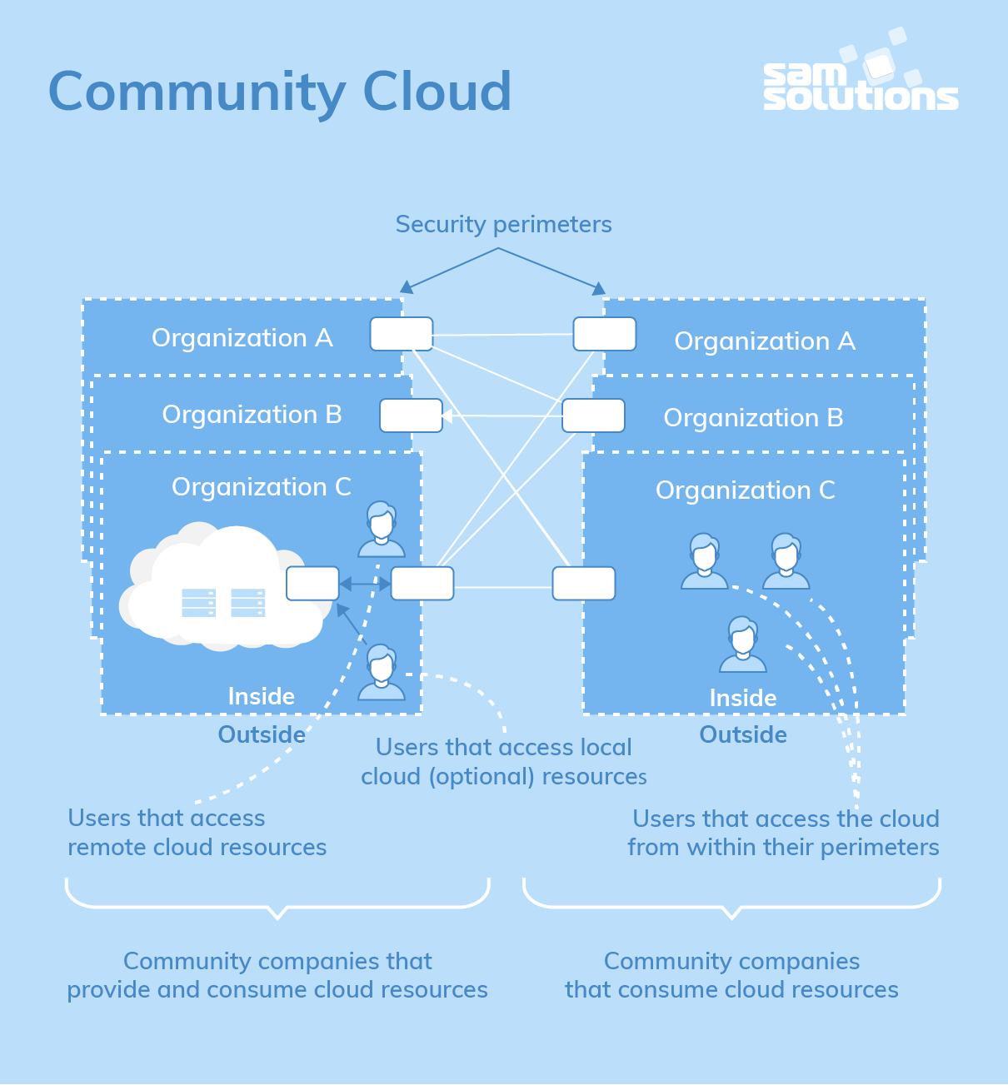

Slide 76
Advantages and Disadvantages
The Strengths of a Community Cloud
  Cost reduction
  Improved security, privacy and reliability
  Ease of data sharing and collaboration
The Shortcomings of a Community Cloud
  High cost if compared to a public deployment model
  Sharing of fixed storage and bandwidth capacity
  It is not widespread so far

Slide 77
Hybrid Cloud
As it is usually the case with any hybrid phenomenon, a hybrid cloud encompasses the best features of the above-mentioned deployment models — public, private and community ones. It allows companies to mix and match the facets of all three types that best suit their requirements.
Hybrid cloud deployment model not only safeguards and controls strategically important assets but does so in the most cost- and resource-effective way possible for each specific case. Also, this approach facilitates data and application portability.

Slide 78
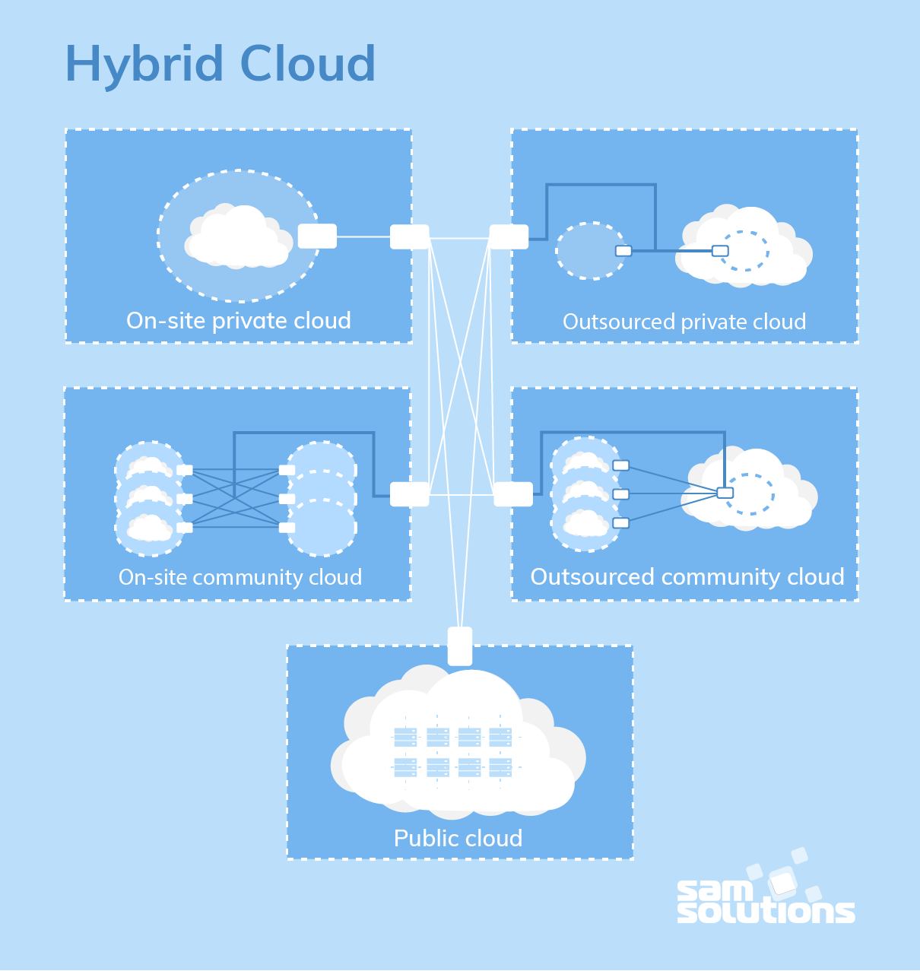

Slide 79
The Benefits of a Hybrid Cloud
Improved security and privacy
Enhanced scalability and flexibility
Reasonable price

Slide 80
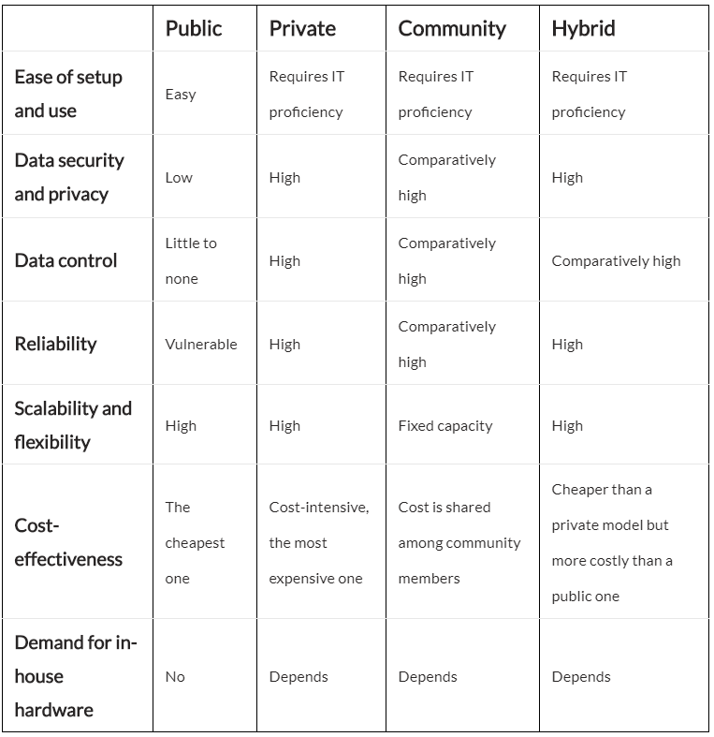
The Comparison of Top Cloud Deployment Models

